Slide 1
Example of Quantitative Research in Criminology
Zubin Jelveh
Feb 2, 2025
Prepared for CCJS 418i

Slide 2
About Me
Computer Science Ph.D. but worked mostly with social scientists.
College of Information & CCJS
In CCJS I teach CCJS418E, Coding for Criminology
Thinking like a programmer
Introduction to Python
Data analytics
Visualization

Slide 3
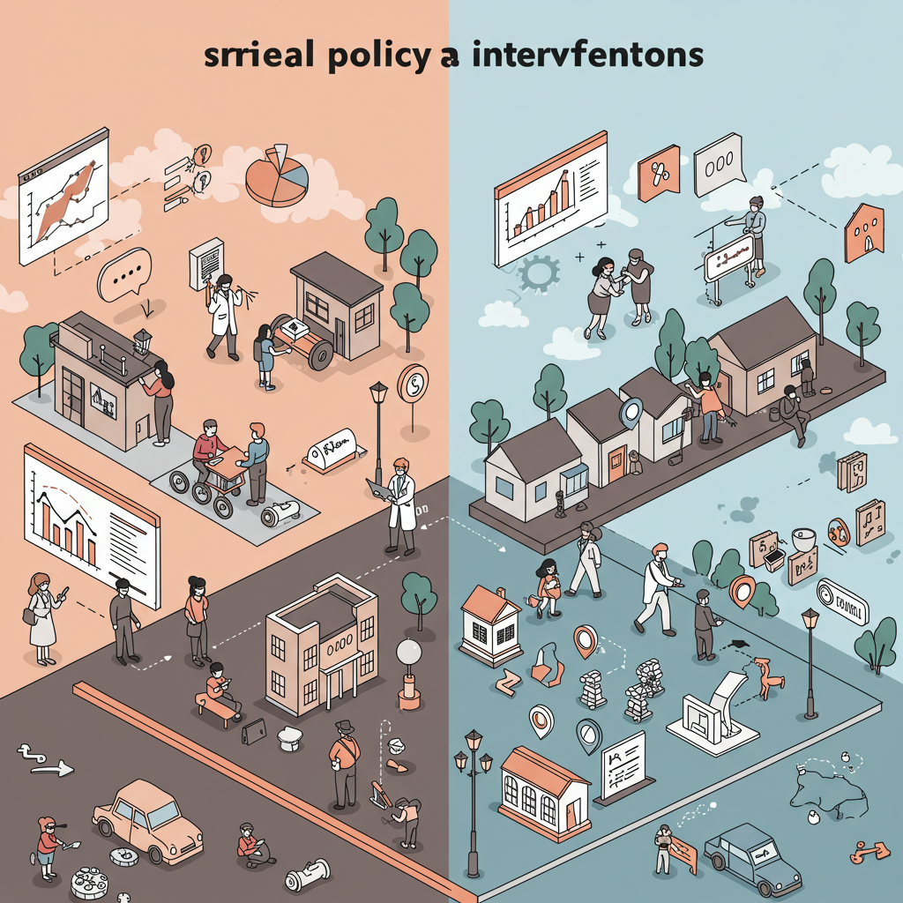
The “Medical Model” for Social Policy
Randomized Control Trials in medicine are considered the gold standard for understanding what works
Economists: Can we apply the same “rigor” in an apolitical manner to studying criminal justice policy?
(Graphic source: Imagen3 and the images/text in its training data)

Slide 4
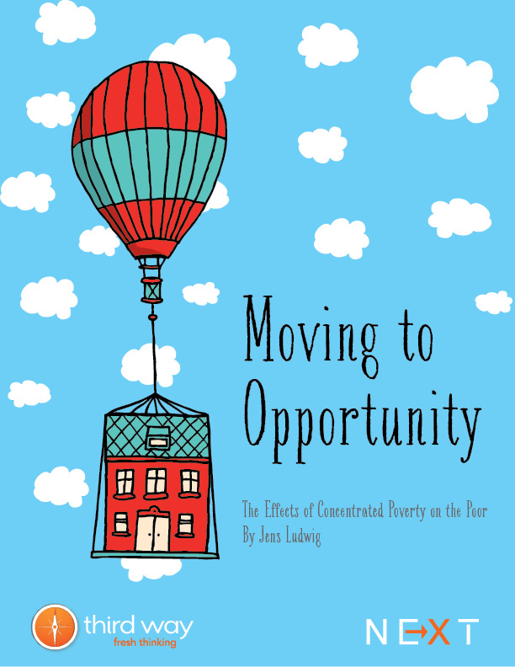
Example: Moving to Opportunity
From 1994-1998, HUD randomly assigned 4,600 low-income families in high-poverty public housing to:
Treatment group: Housing vouchers restricted to low-poverty neighborhoods + counseling
Control group: No vouchers, remained in public housing
Key medical RCT elements used:
Random assignment
Control group
Clear intervention "dosage"
Long-term follow-up (10-15 years)
Multiple outcome measures (health, education, income)
Results showed significant impacts on adult health and female youth outcomes, but mixed effects on economic self-sufficiency. Not a pancea by any means.

Slide 5
Machine Learning in Social Policy
Decisions usually involve a prediction about the future
Examples:
Pretrial: Who should get released pretrial?
Policing: When/where will crime happen again?
Services: Who should be prioritized for services that would reduce future involvement with CJ system?
Can algorithms do a better job than humans in forecasting the future?
Today I’ll talk about the considerations involved in using ML for policy
Incorporating ML into the medical model typically involves figuring out who is appropriate for the intervention

Slide 6
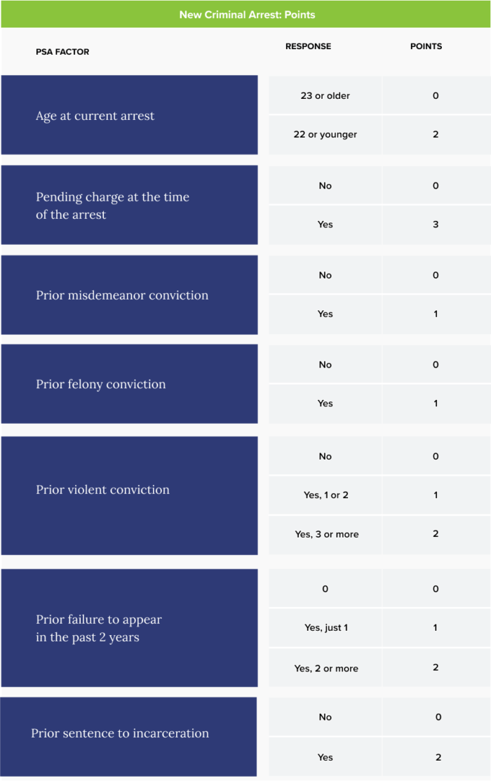
What Does an Algorithm Look Like?
Public Safety Assessment for Pretrial Risk
Factors are associated with points.
The model in our paper today is going to be a more complicated version of this.

Slide 7
Machine Learning Can Predict Shooting Victimization Well Enough to Help Prevent It Sara B. Heller, Benjamin Jakubowski, Zubin Jelveh, & Max Kapustin

Slide 8
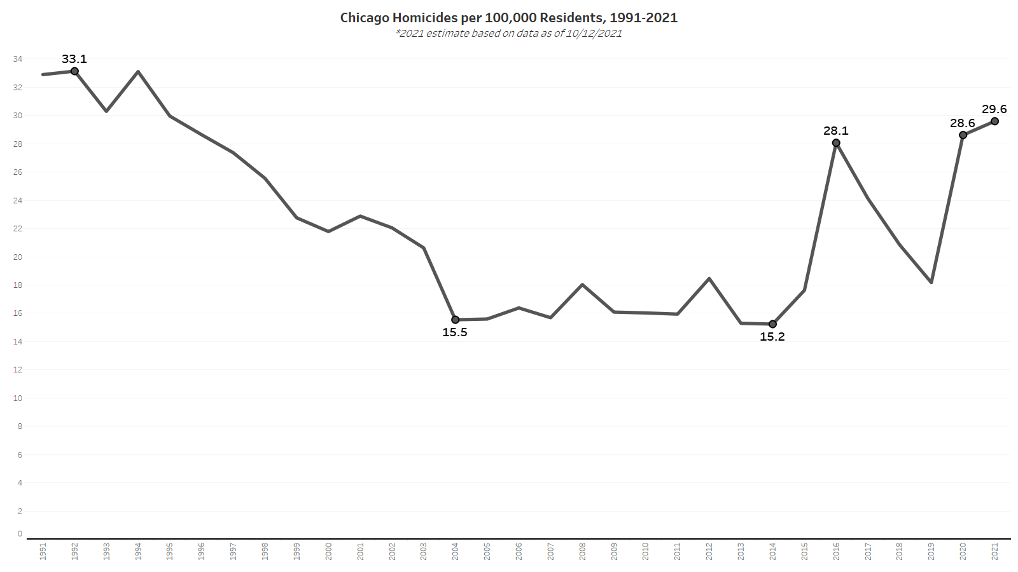
Notes:
15% lower than the peak in the 90s

Slide 9
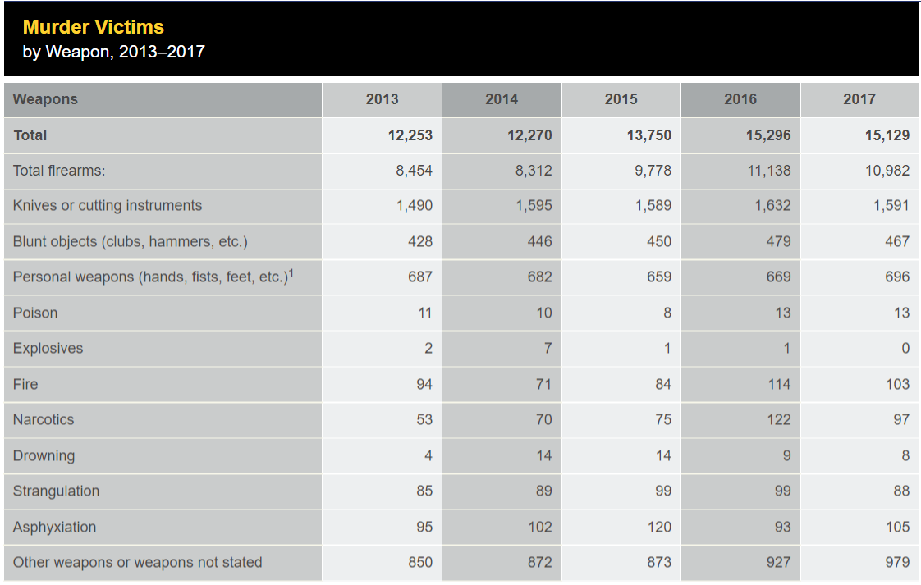

Causes of Homicide
In 2016, firearms accounted for 10,982 out of 15,129 homicides, 72.5%
Source: FBI UCR

Slide 10
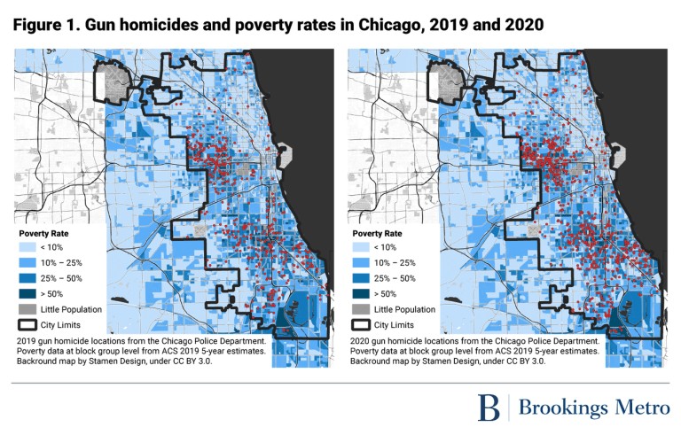
Gun Violence Is Highly Concentrated
Geographically, within disadvantaged neighborhoods (Cook & Ludwig 2000; Sampson, Raudenbush & Earls 1997; Sampson 2012; Sharkey 2013)
Demographically, with young black men dying from gun homicide at 20 times rate of white counterparts (CDC 2019)

Slide 11
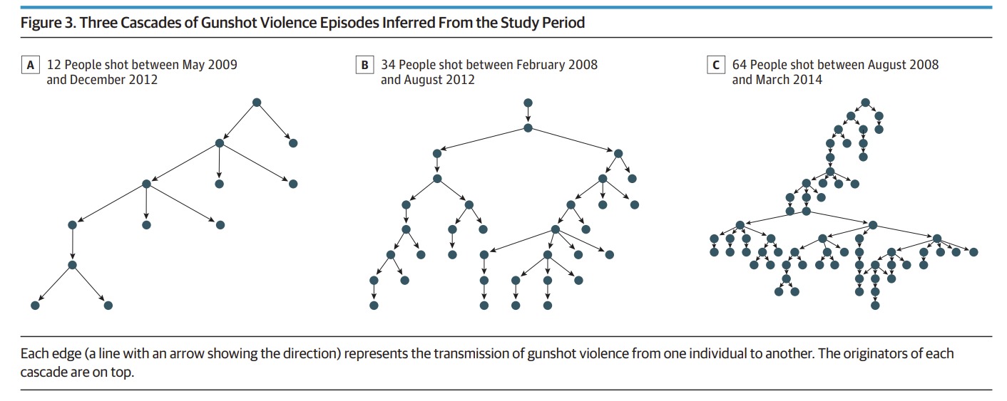
Gun Violence Is Highly Concentrated
Socially, among young men with criminal justice contact, within networks (Braga 2003; Green et al. 2017; Papachristos et al. 2015)

Slide 12
The Patterns of Concentration Give Hope
Predictable: If the risk can be predicted ex-ante, can be used to direct interventions
Costly: Shootings are very costly (to the victim and the community)
People at high risk of being a shooting victim receive no programming
Reducible: Promising interventions have been shown to be effective in reducing arrests (CBT + Summer Jobs)
Cost-Effective Interventions: Most investments would likely pay for themselves if they are effective

Slide 13
Concerns about prediction
“Bake-in” bias that exists in the training data
Lack of transparency
This paper:
Use Chicago policing data to predict shootings, assess the benefits and limits for reducing gun violence

Slide 14
Which Shooting Type to Predict?
Most proximate cause of shootings are shooting offenders
So, should we have our algorithm predicts who will be a shooter?
In order to measure offending, we have to use arrests
The share of shootings that lead to an arrest is very small < 20%

Slide 15
Is the outcome measured cleanly?
I.e. w/ little error?
Some shooting offenders are “selectively labeled” when they are arrested
Some have no opportunity of being arrested (police never get any leads)
Upshot: Shooting offending will have measurement error
All arrest outcomes will suffer from this

Slide 16
What about shooting victimization?
If gun shot results in hospitalization, must be reported to police
Severe shootings are well-measured
What’s missed?
“Grazings” that can be treated outside of hospital
Intention to shoot a person, but miss
Predict shooting victimization instead of shooting offending

Slide 17
Why Chicago?
- Higher violence rate than NYC, LA; less than Baltimore, St. Louis, Detroit; similar to Philly
Size + violence rate = sufficient data to train, test model
Training data likely to reflect disparities given history of problematic policing practices

Slide 18
Agenda
Data
Features
Prediction Model
Results overall
Results by subgroup
Potential Impact

Slide 19
Data
12 million CPD juvenile & adult arrest and victim records, 1999-2019
Define 1,400+ features
Demographics
Arrests and Victimizations
Networks

Slide 20
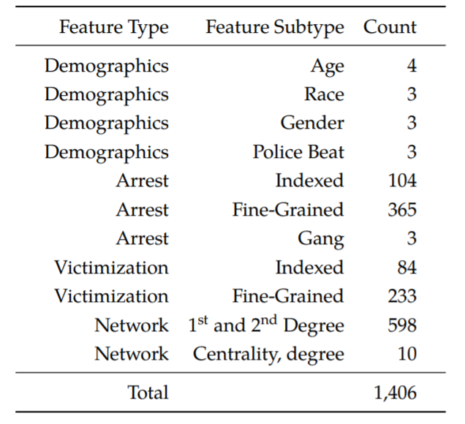
Feature Types
Demographic
Age, race, gender, geography
Arrests
Number of prior arrests in the last year, two years
Number of prior arrests of type X in the last year, two years, etc
Victimizations
Similar but on victimization side

Slide 21
Network Features
Person A and Person B get arrested together
Person A is young and has no arrest history
Person B is older and has many previous arrests was previously arrested with Person C
Person B was also previously arrested with Person C, who was previously a shooting victim
C
Arrest Event
A
B

Slide 22
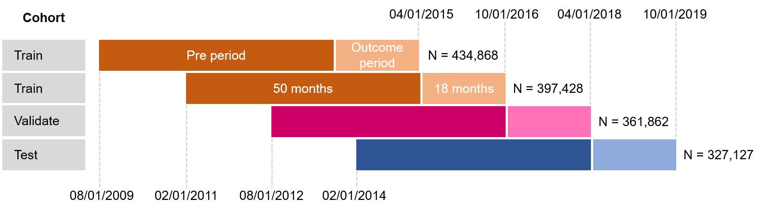
Prediction Setup

Slide 23
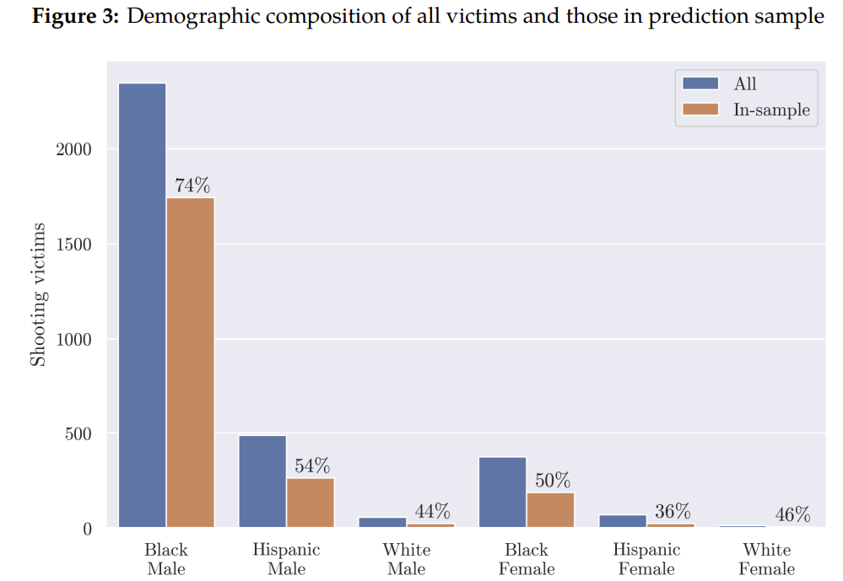
Who Can We Predict For?

Slide 24
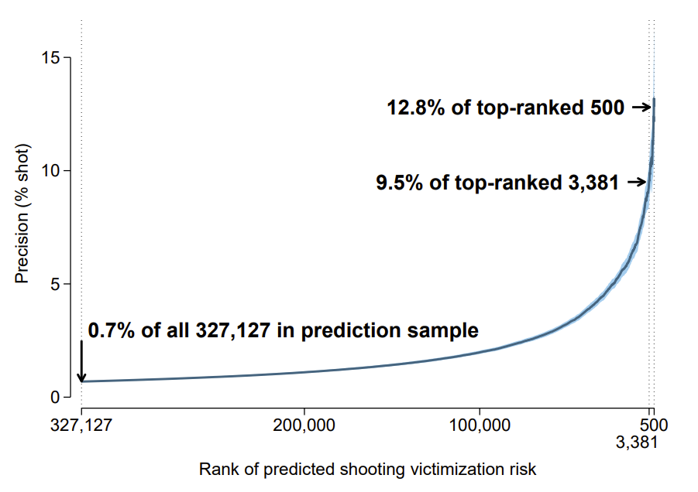
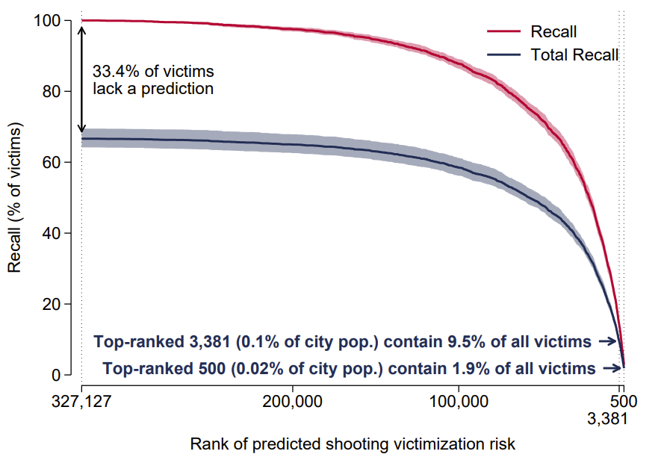
Performance

Slide 25
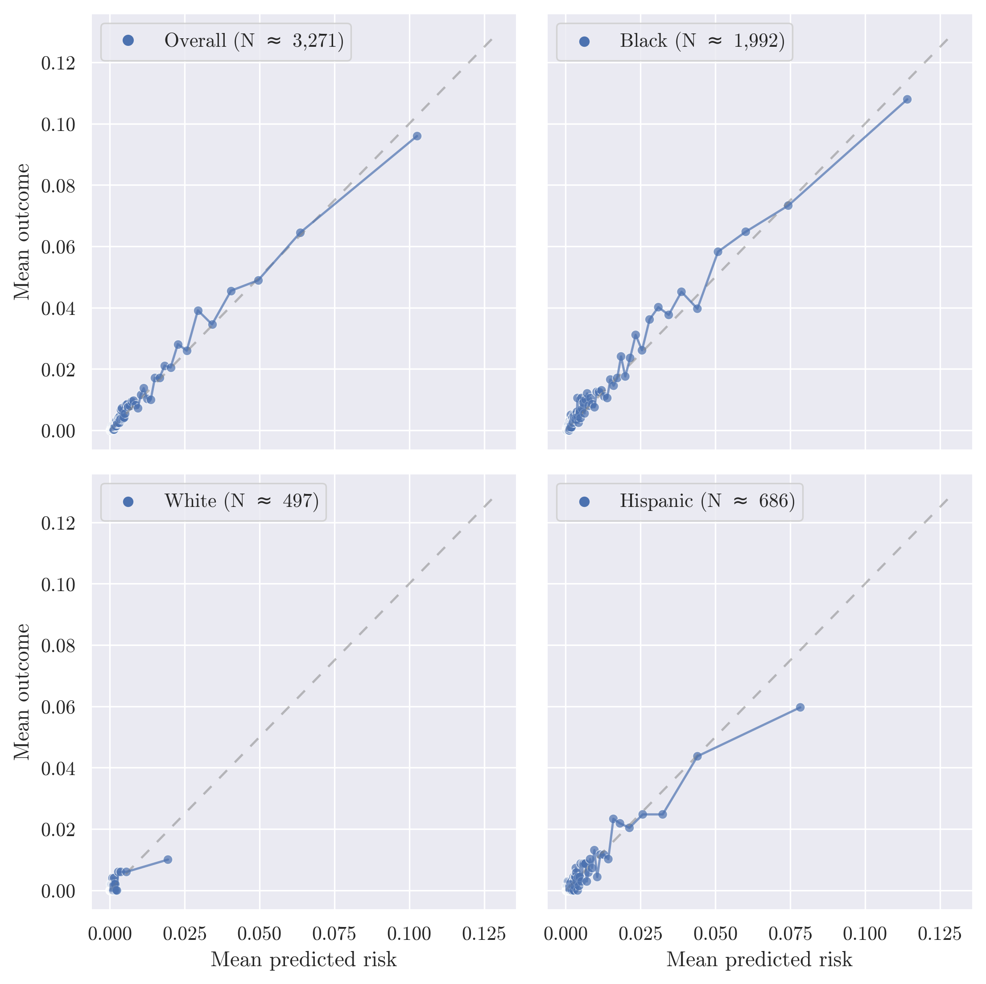
Calibration
Each dot is 1 percent of the prediction sample
Over 90% of the sample gets a predicted probability less that 5%
We appear to be calibrated overall (top left chart)
Some over-prediction for Hispanic and White subgroups relative to Black

Slide 26
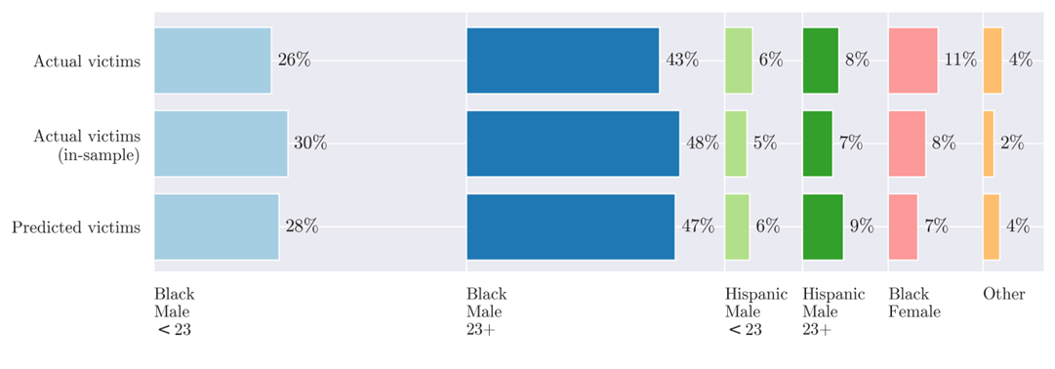
Who Gets Identified

Slide 27
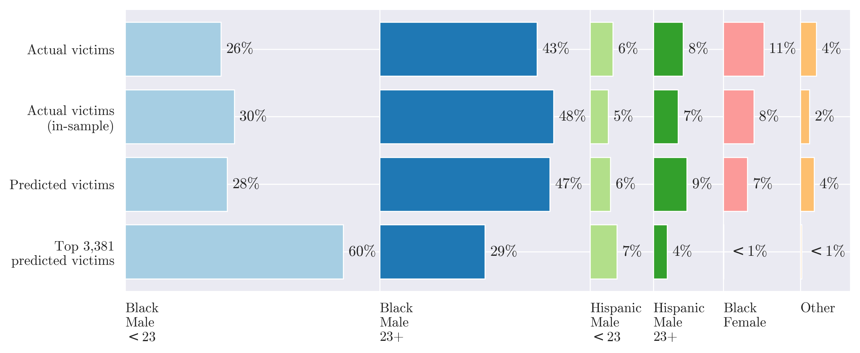
Who Gets Identified

Slide 28
What Drives Performance?
Crude hypotheses?
Victimization outcome → victimization records?
Arrest records are biased → not arrest records?
Demographics → We just need a simple model?

Slide 29
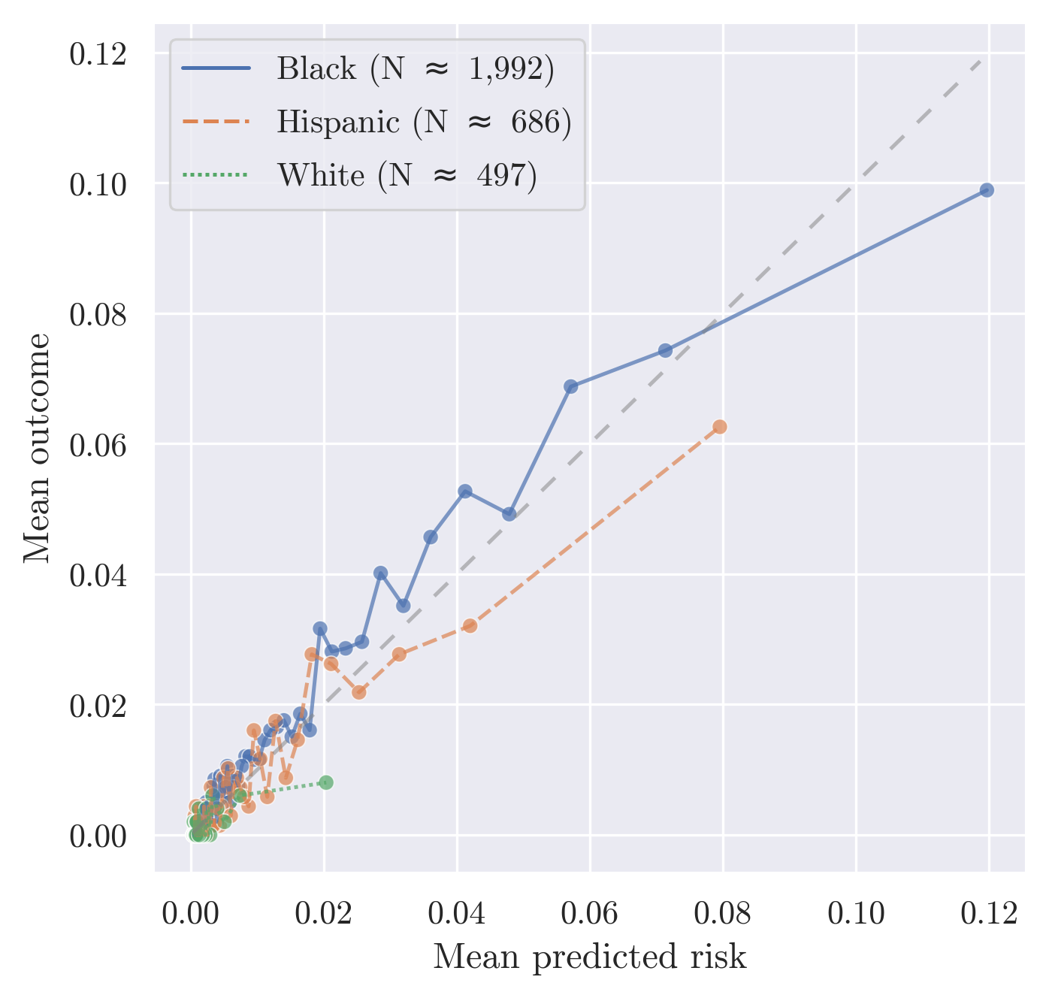
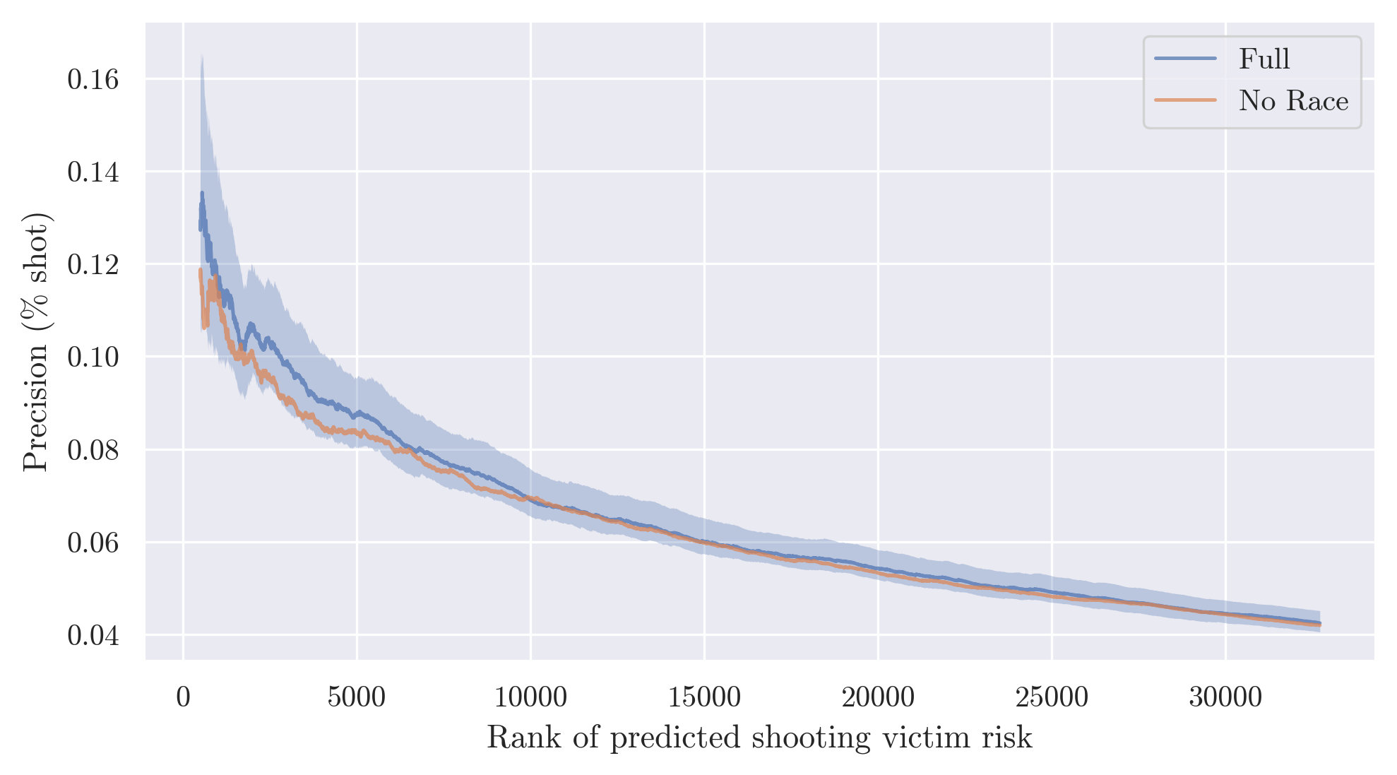
Minimal Impact from Dropping Race Feature

Slide 30
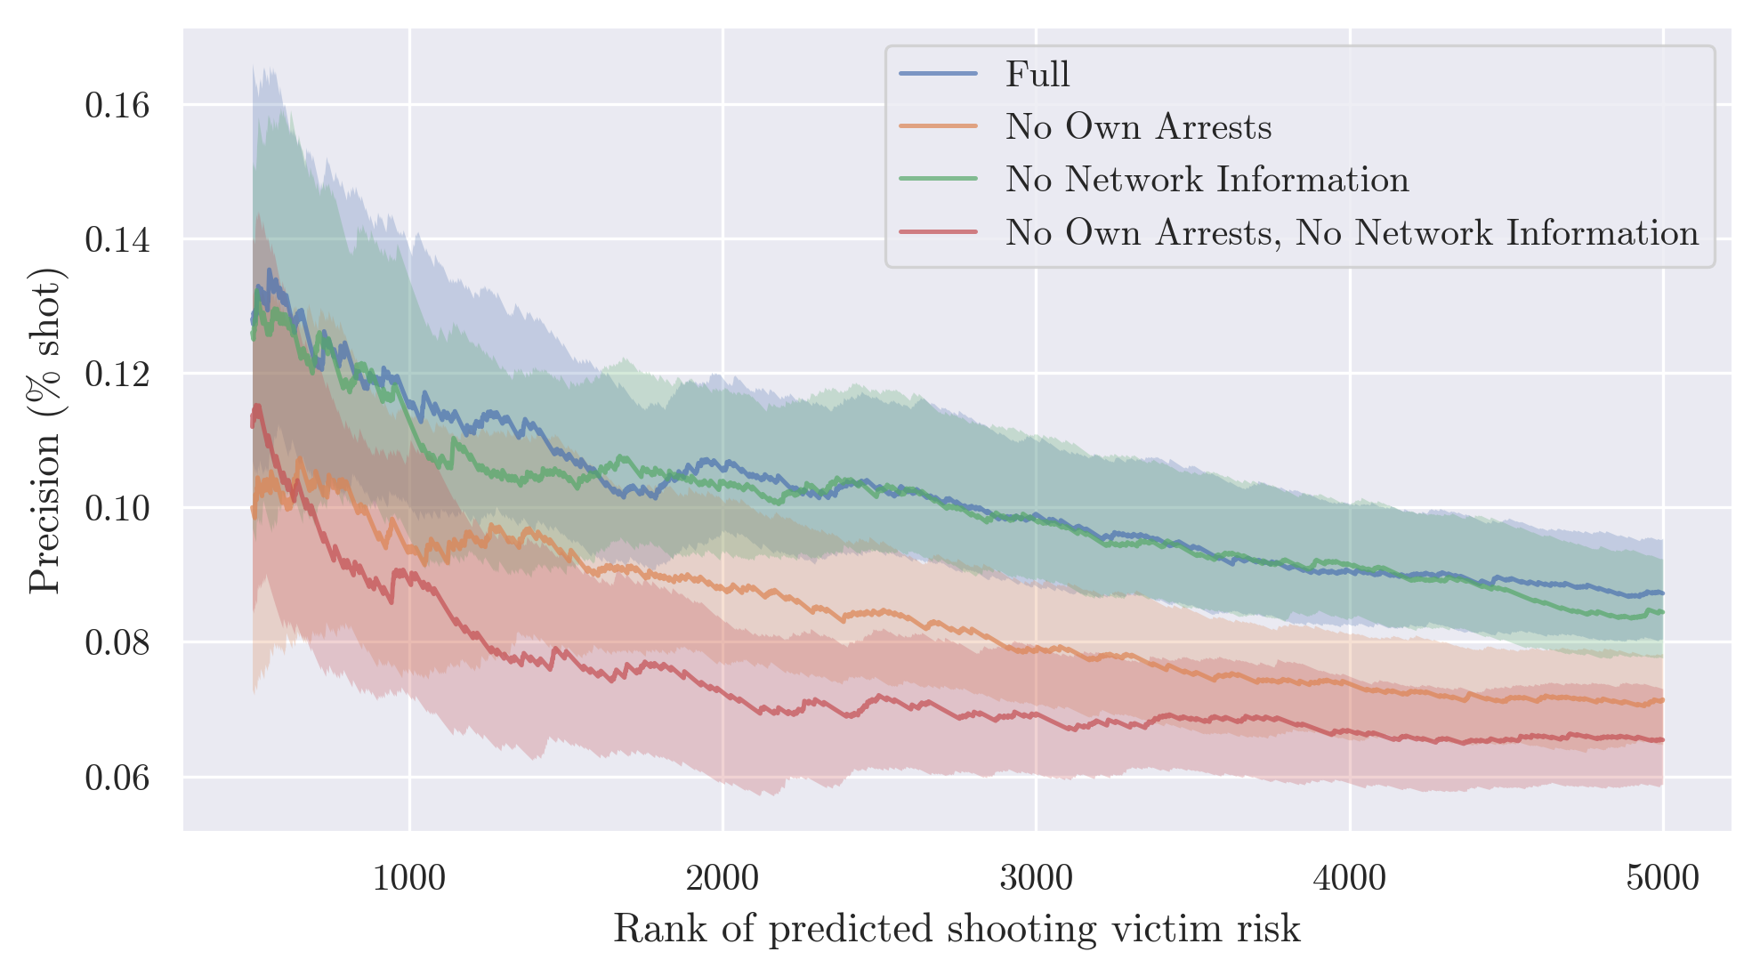
What Features Drive Performance? (Leave out one feature family)

Slide 31
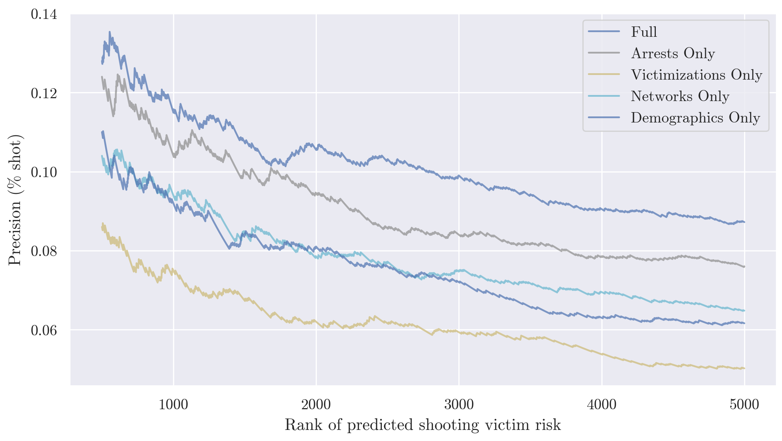
What Features Drive Performance? (Run w/ one feature family)

Slide 32
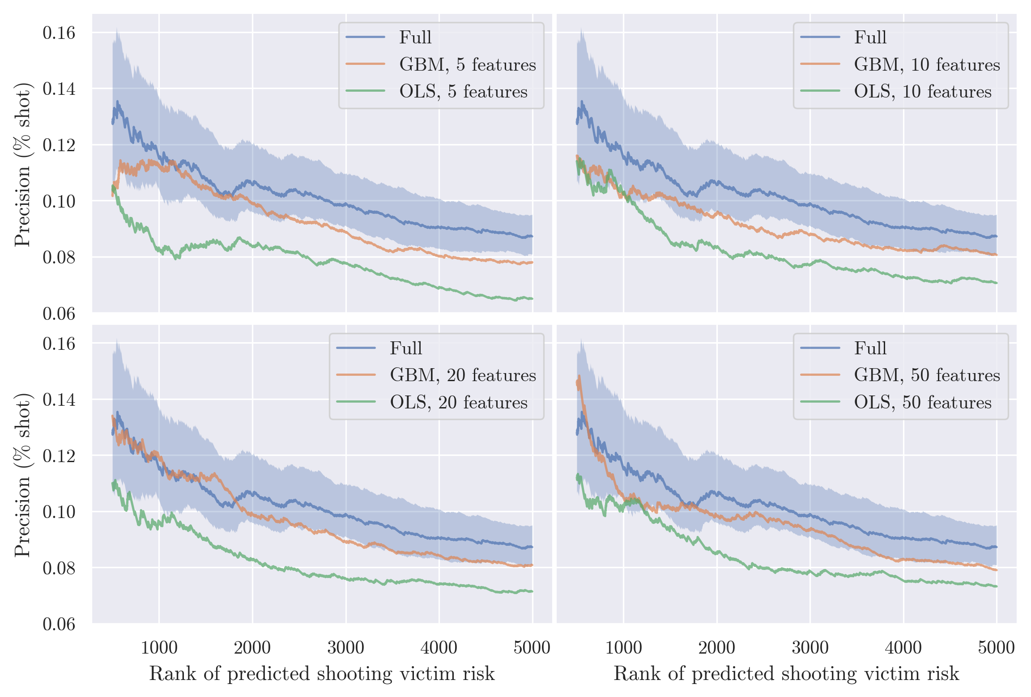
More Flexibility vs More Data
Compare Full model
GBM
1,400+ features
GBM + OLS models with many fewer features

Slide 33
Potential Impact
Top 500 people account for 65 shooting victims (13%)
Treat all w/ CBT + Jobs. Cost $20k per person = $10 million
If CBT + Jobs reduced this risk by 50%: 65 victims to 33 victims
Cost of shooting victimization would have to be $300,000 to break even. (Cook + Ludwig 2000 estimate WTP of ~$650K)

Slide 34
In the Real World
A version of this algorithm was used in the real world.
High-risk individuals were offered a suite of services:
Guaranteed employment while in the program
Cognitive Behavioral Therapy
Case management
Individuals were identified via:
Community outreach workers (Humans)
Machine Learning (Algorithm)
(Re-entry from jail)

Slide 35
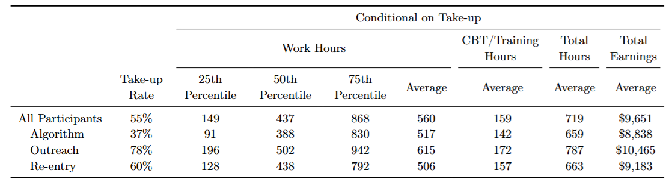
Engagement by Pathway

Slide 36
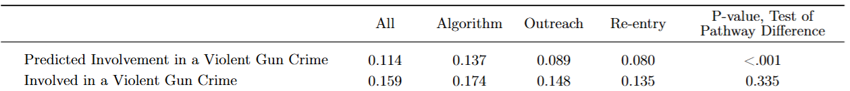
Baseline Risk by Pathway
Algorithm-selected individuals were
Predicted to be 53%
Actually 18%
more likely to be involved in a gun crime

Slide 37
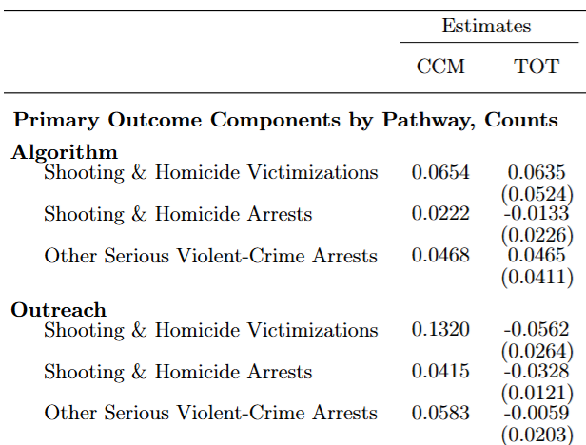
Effect of Intervention by Pathway
Algorithm-selected individuals were no less likely to be victimized or arrested in a gun-related incident
Human-selected individuals showed large reductions
42% less likely to be victimized
79% less likely to be arrested

Slide 38
Conclusion
Targeted prevention approaches for shooting victimization can be cost effective
At the same time, population level impact is likely to be quite small (98% of victims not in top 500, 90% not in top 3,381)
Best able to identify risk for young Black men
Potentially biased arrest data can be used for social good
To maximize accuracy, a black-box approach is likely to be needed
Remains to be seen: Can similar predictive accuracy be obtained in other jurisdictions?

Slide 39
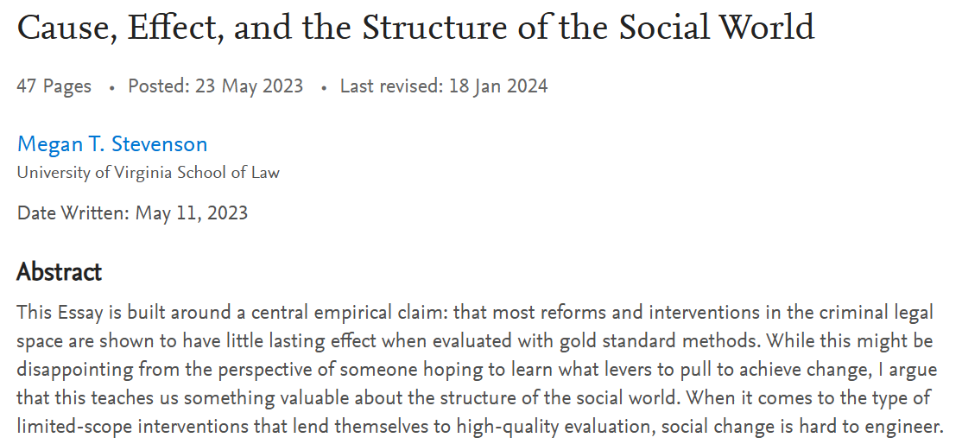
Bigger Questions
Is the “medical model” approach to social policy useful?
Especially when most of our problems have deep sociological roots?
Medical model may be useful on the margins, but unlikely to address systemic drivers of disparities

